Slide 1
Name- TUHIN PAUL
Roll- 30054619012
Stream- B.Sc in IT(AI)
Reg no.- 043598
Date of Submission-13/06/21

Slide 2
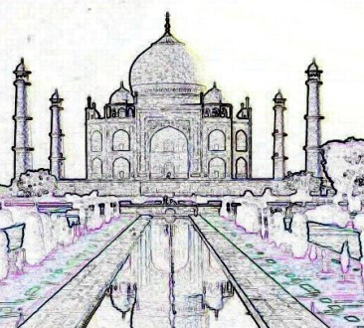
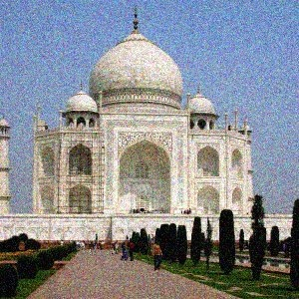
Edge Detector
Why do we use an Edge Detector?
>We use Edge Detector just to know the out lines of a certain image.
Input Image:
Output Image:

Slide 3
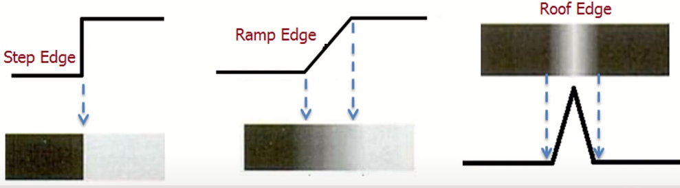
Types of edges :

Slide 4
Steps required for Edge Detection
Step 1: Image Smoothing
Step 2: Edge Detection
Step 3: Edge Localization
Let’s elaborate these steps in furthur details .

Slide 5
Step I: Image Smoothening
The input image may have a lot of noises in it, so we need to remove or suppress the noise, without reducing the quality of the image.
Step II: Edge Detection
In this step the Noise alone will be removed completely leaving just the edges.
Step III: Edge Localization
Thinning , Linking are carried out in this process which helps in detecting the clean Edges and helps in tracing the edges .

Slide 6
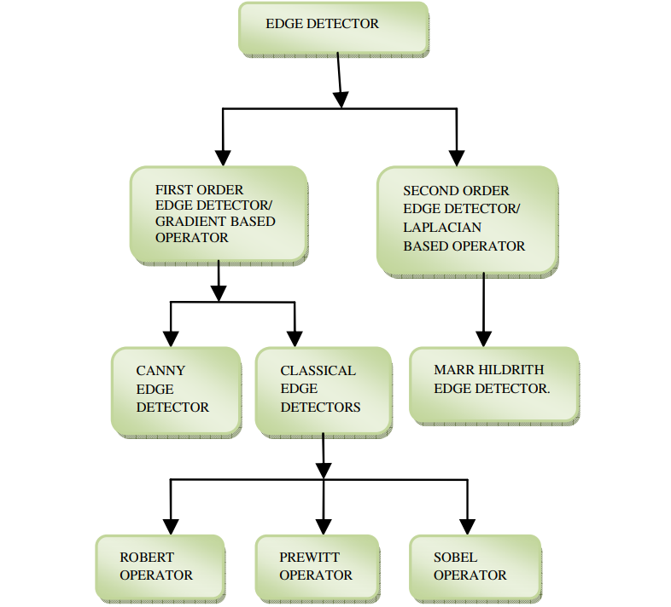
Types of Edge Detector

Slide 7
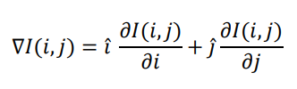
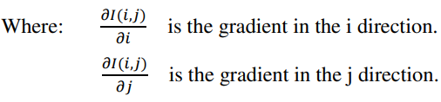
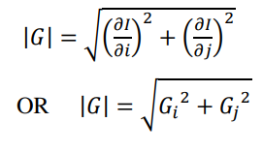
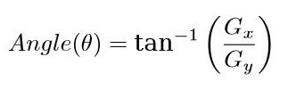
First Order Based Edge Detector
It is based on the use of a first order derivative, or can say gradient based. If I (i , j) be the input image, then image gradient is given by following formula .
The gradient magnitude is computed by the following formula:
The magnitude of gradient computed above gives edge strength and the gradient direction is always perpendicular to the direction of edge.

Slide 8
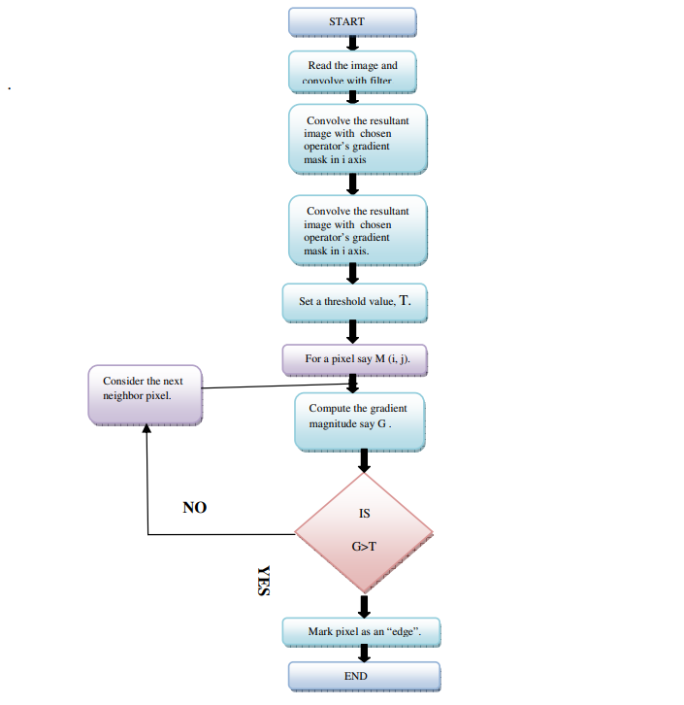

Slide 9
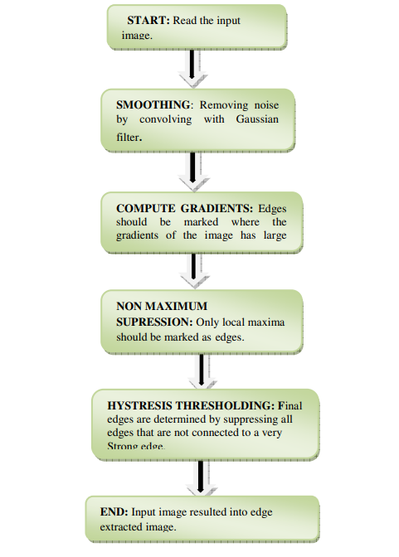
Flowchart for Canny Edge Detector:

Slide 10
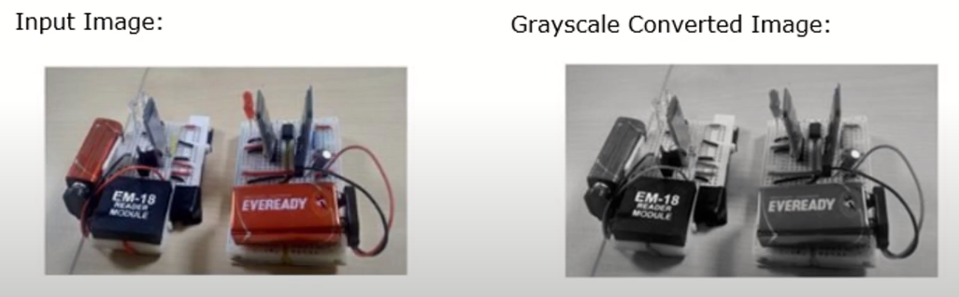
Canny Edge detector
This Edge Detection Technique does not work like other Edge Detection techniques , it suppresses the noise flawlessly .
Procedure of using the Canny Edge Detector:
Step I:
Convert the RGB image into a Grayscale image

Slide 11
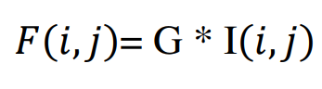
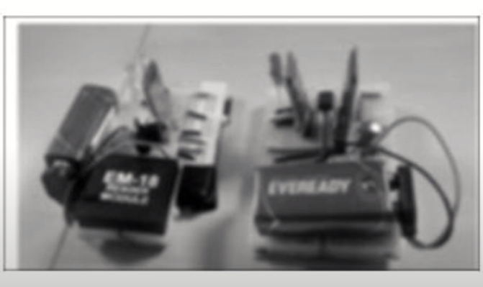
Step II: Remove noise using Gaussian Blur.
(It is an operator that helps in removing Noises completely present in the input image, shall enable further processing to smoothen the image .)
Formula :

Slide 12
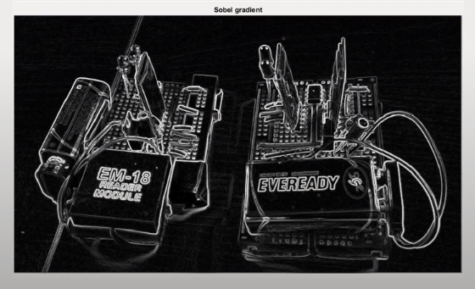
Step III: Intensity Gradient Calculation
In this step the normal Sobal Edge Detection step is followed , An Edge is the sudden change in an intensity of a pixel.
Now the sobal operator will be applied over the input image, the steps remains the same , as in the Sobel Edge Detector . The resulting image looks like this.

Slide 13
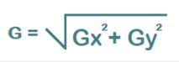
Now all we have to do is calculate the gradient just as we did in the case of sobel edge detector
The resulting Gradient is calculated by this formula :
And the threshold is considered , if the value of the gradient is greater than the threshold then it will be considered as an edge, else not.
The edge direction is calculated as :

Slide 14

Step IV: Non- Maximum Supression
The gradient magnitude operators discussed during the Sobel edge detector , normally obtains thick edges , but the final image is expected to have thin edges. This process helps in obtaining the thin edges.
We already have the edge direction available , the subsequent step is to relate the edge direction to a DIRECTION that can be sketched in the image. It is actually the prediction of how the movement of edges could happen.
An example is always handy, we will consider a 3x3 matrix , It is all about the colors that is to be visualized as 3x3 matrix.

Slide 15
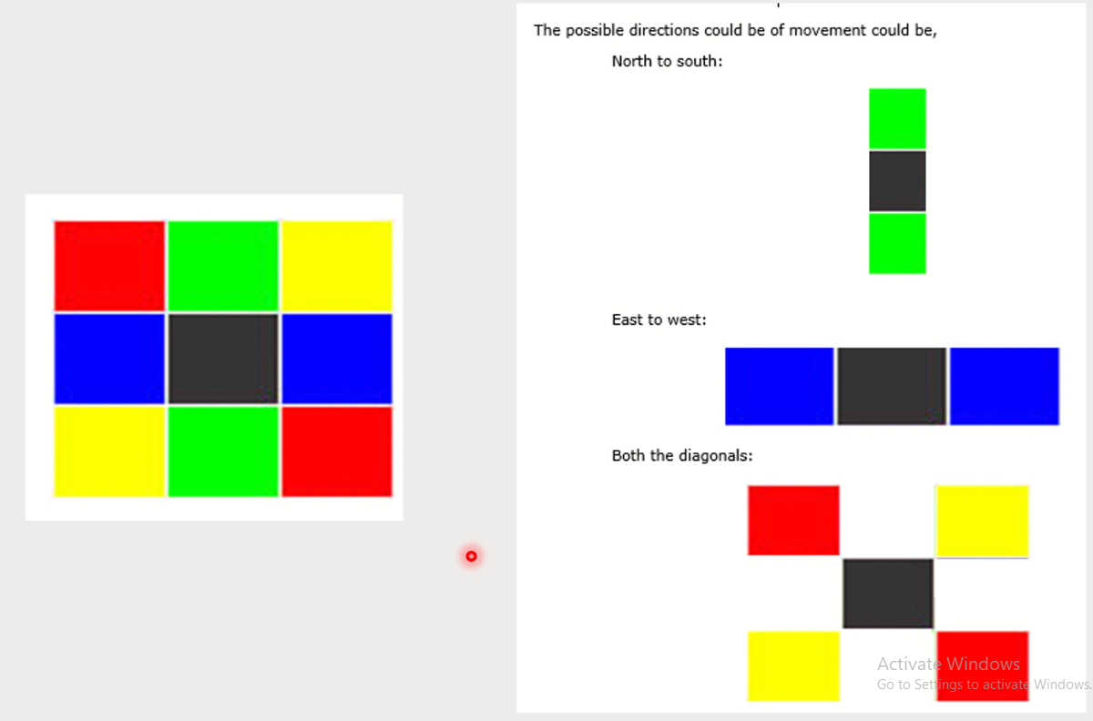

Slide 16
The central cells the region of interest .
There can only be 4 directions for any pixel that is :
O Degree
45 Degree
90 Degree
135 Degree
Hence it forces us to a direction where the edges has to be definitely oriented to one of these four directions .
If the orientation angle is observed to be 5 degree then it will be taken as O degree . Similarly , if it is 43 degrees , it shall 45 degrees.
For ease of understanding we have drawn a semicircle with color shading. It is representing 180 degrees.

Slide 17
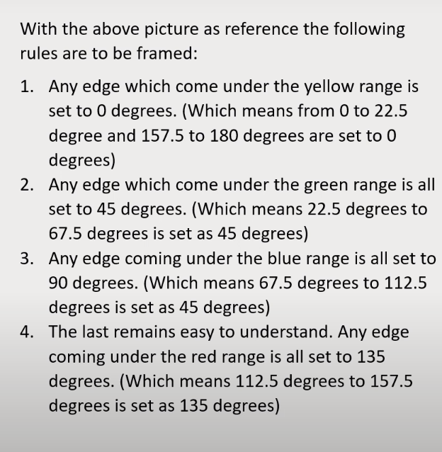
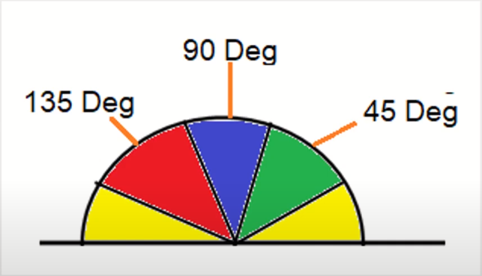

Slide 18
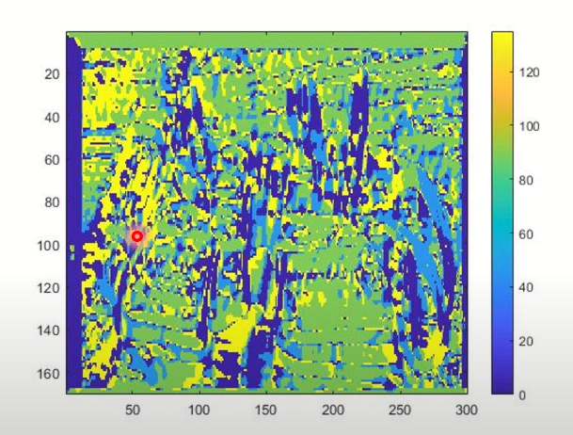
After this process , direction of the edges is mapped to any of the 4 directions mentioned above , The input image shall now look like this.

Slide 19
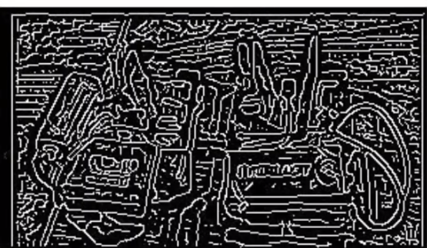
The last step is to apply the non-maximum suppression , as we have found all the edge directions.
Non-maximum suppression is the process where the pixel value with zero value is suppressed, and will not be considered as an edge. This will enable the system to generate a thin line in the output image.

Slide 20
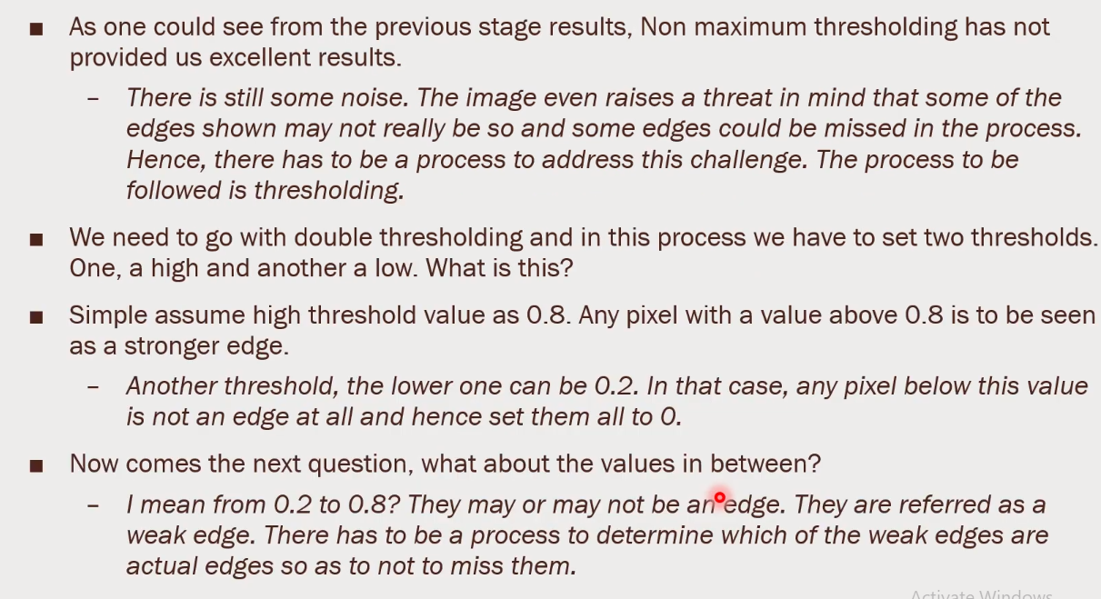
Step V: Thresholding

Slide 21
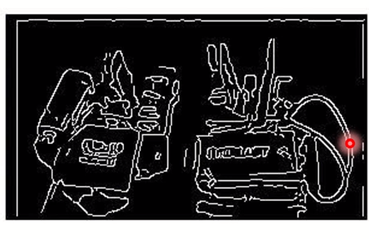
Step VI: Edge Tracking
As discussed in the previous step , now it is important for us to understand which of the weaker edges are actually edges.
A simple edge has to be followed , we can call the weak edges as strong edges if they are attached with the strong edges and retain them .And weak edges that are not connected with the strong edges are to be removed.
Step VII: Final Cleansing
This is the final process in the process the final weak edges are to be removed. And this finally leaves us with this image.

Slide 22
Advantages of Canny Edge Detector :
Less Sensitive to noise:
As compared to classical operators like Prewitt, Robert and Sobel canny edge detector is less sensitive to noise. Its uses Gaussian filter which removes noise at a great extent as compared to above filters. LoG operator is also highly sensitive to noise as differentiate twice in comparison to canny operator.
2. Remove streaking problem:
The classical operators’ like Robert uses single thresholding technique but it results into streaking. Streaking means, if the edge gradient just above and just below the set threshold limit it removes the useful part of connected edge, and leave the disconnected final edge. To overcome from this drawback canny detector uses ‘hysteresis’ technique which uses two threshold values ‘t high’ and ‘t low’as discussed above in canny algorithm.

Slide 23
3. Adaptive in nature:
Classical operator have fixed kernels so cannot be adapted to a given image. While the performance of canny algorithm depends on variable or adjustable parameters like sigma which is the standard deviation of Gaussian filter and threshold values
’t low’, and ’t high’ .Smaller the value of sigma results smaller Gaussian filter in turns results in finer edges. So user can change these parameters and can improve the result of canny algorithm..

Slide 24
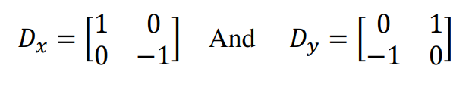
Robert Edge Detector
It is gradient based operator. It firstly computes the sum of the squares of the difference between diagonally adjacent pixels through discrete differentiation and then calculate approximate gradient of the image. The input image is convolved with the default kernels of operator and gradient magnitude and directions are computed. It uses following 2 x2 two kernels
The plus factor of this operator is its simplicity. The main disadvantages of this edge detector are :
Even mask(Good mask always has to be odd in number as by this we will be able to get a centre in which we have main interest)
Less Neighbourhood(Only one neighbour at a time can be seen)
Small size(2x2 convoluted matrix and hence requires a lot of calculations)

Slide 25
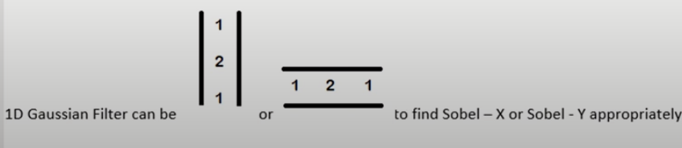
Sobel Edge Detector
The image will be first processed in the x and y direction .
The image so formed will be the summation of both the edges of x and y axis
Then the next step is to calculate the gradient of the image intensity of every
pixel within the image.
Note-
The kernel values for the sobel filter should be fixed and it cannot be altered.
The Gaussian filter play a vital role in this process . The fundamental idea behind The Gaussian filter is that the centre should have greater weight(interest) than the rest .
#The general approach for detecting the edges is by considering the first and the second order derivative.

Slide 26
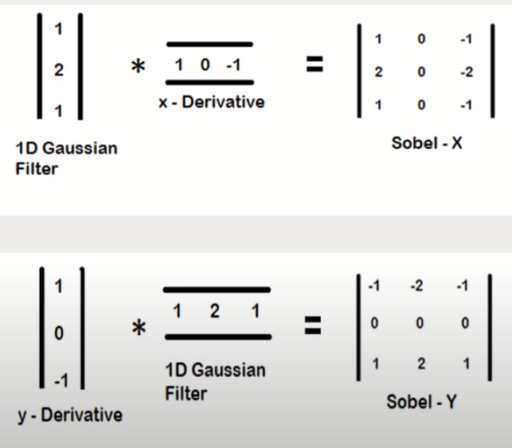



Slide 27
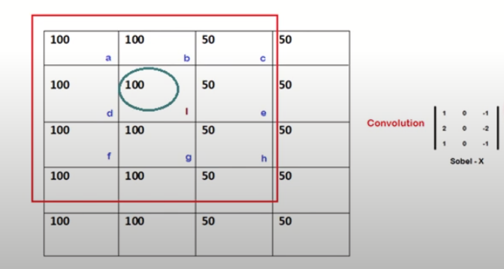
Now the sequence will be convoluted with the Gx(Sobel X) and Gy(Sobel Y)
Over the input image that shall allow us to calculate the value for one pixel at a time
Then the shift happens towards right , the next column shift towards right , similar process is followed for the rows , which is from top to bottom , for columns it is from left to right and for rows it is hovered from top to bottom.
Note- Here ‘i’ is the centre of attraction.

Slide 28
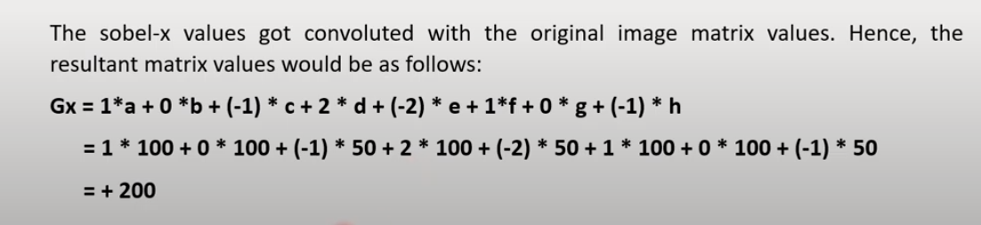

Slide 29
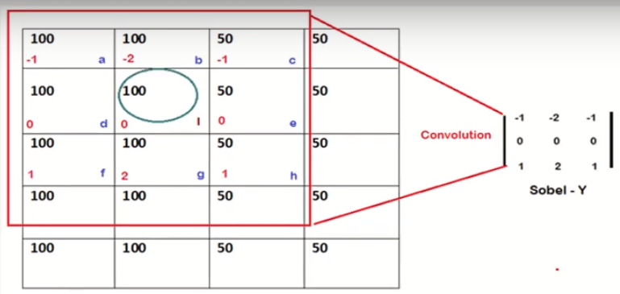
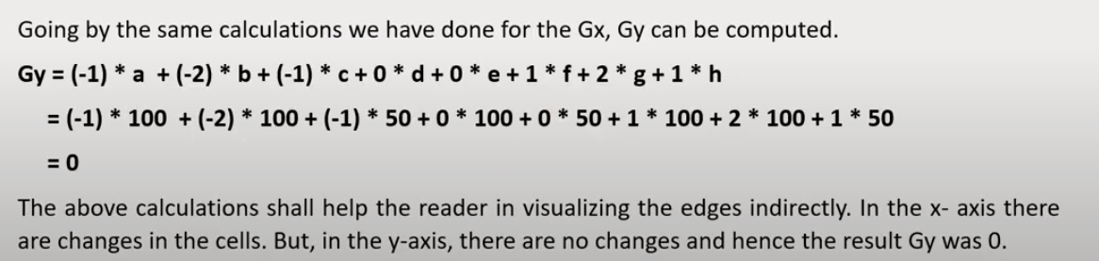

Slide 30
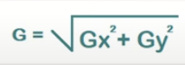
The previous calculation will help in visualizing the edges of the image , and moreover the gradient of the X axis there were some changes in the cells but in case of the Y axis the cells are unchanged, So the value of Gy = O.
The resultant gradient approximation can be calculated with this formula
Note-
Now the value of the gradient will be compared with the threshold value , if the gradient approximation value is greater than the threshold value then it is called as an Edge , else if the value is lower than the threshold then it is not an Edge.

Slide 31
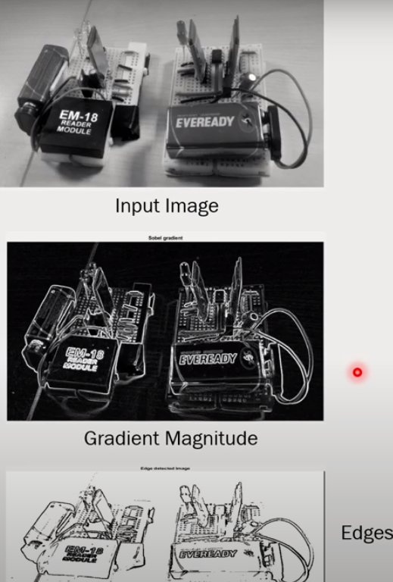
Resulting Image-

Slide 32
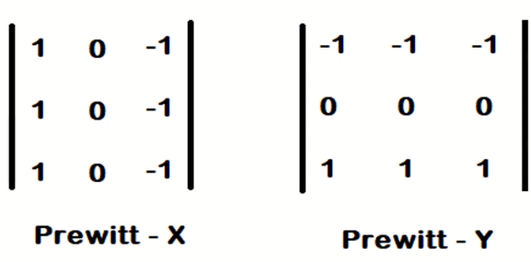
Prewitt Edge Detector
It is the same as the Sobel Edge Detector , The main difference between Prewitt and Sobel Edge Detector is that the values used in the Prewitt Edge Detector must be symmetric around the centre. But the Sobel operator gives weight to the point which is lying close to (x,y) [Note point (x,y) is a point on the image]

Slide 33
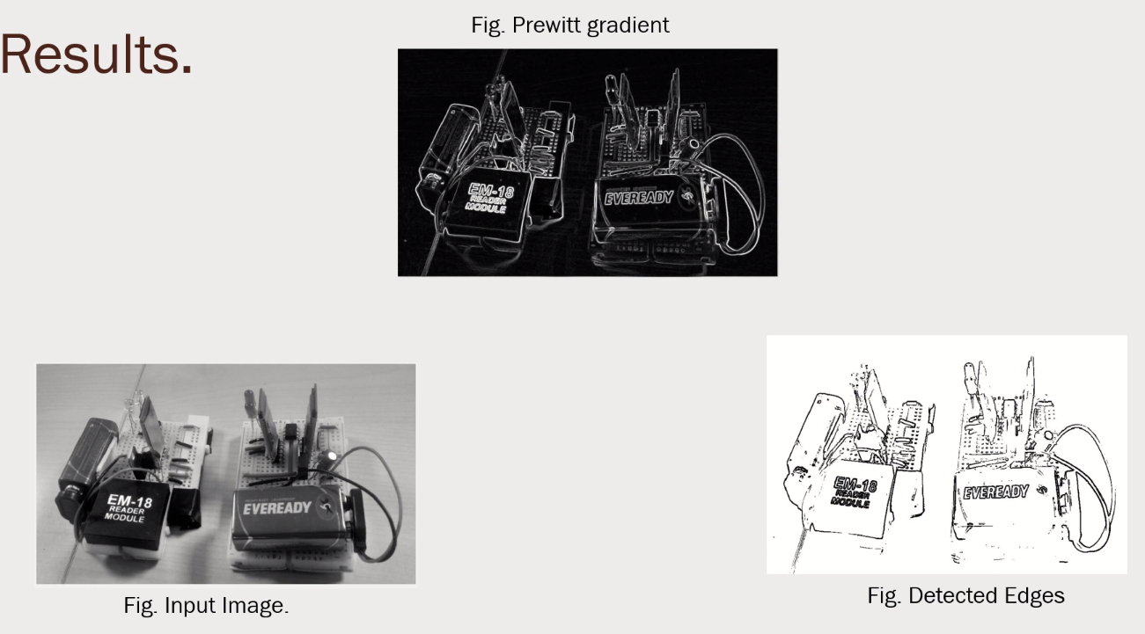

Slide 34
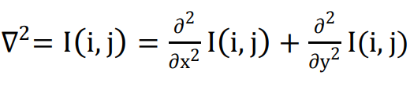
Second Order Edge Detector
It is based on second order derivative, in particular, the Laplacian ∇2.In this operator a pixel is marked as an edge at a position where second derivative of an image becomes zero. The laplacian operator ∇2 for a 2D image I (i, j) is defined by following formula
Laplacian of Gaussian or Marr HildrEth Operator
The Marr-Hildreth edge detector was a very popular edge operator before Canny proposed his algorithm. It is a gradient based operator which uses the Laplacian to take the second derivative of an image. It works on zero crossing method. It uses both Gaussian and laplacian operator so that Gaussian operator reduces the noise and laplacian operator detects the sharp edges.

Slide 35
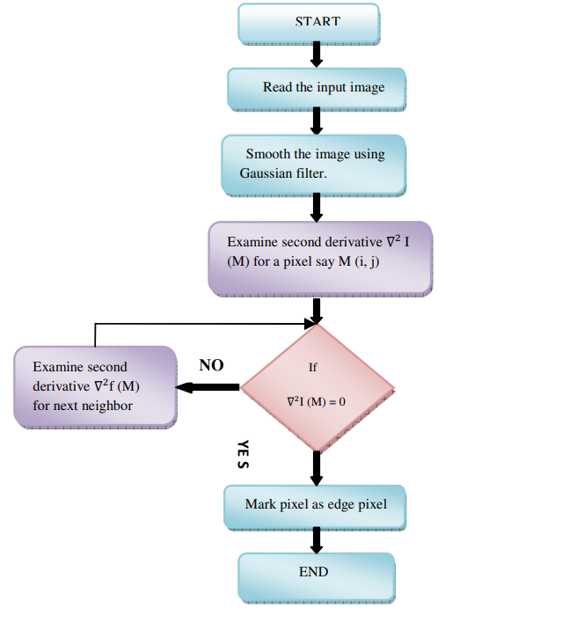
Flowchart of Laplacian Edge Detector

Slide 36
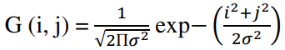
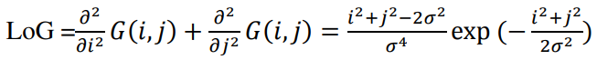
We normally look for the peaks in an image whenever there is a sharp change in the intensity of an image we call it as an edge. But sometime it becomes really difficult to decide whether a point is a peak or not.
So that is the only reason we assume a threshold value , above which we call it a peak value ,and below we ignore it.
The formula of Gaussian function is
Where, E is standard deviation? And the LoG operator is computed from
Disadvantages:
It is very highly sensitive to noise.
It is unable to determine the direction of edges.

Slide 37
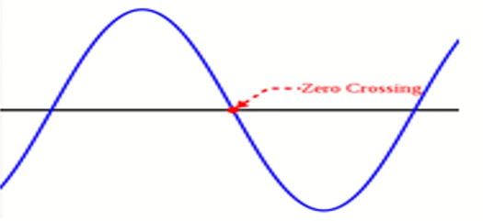
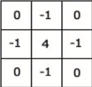
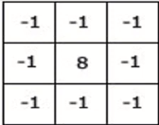
One can see that on the left side the curve rises , it signifies positive slope , and to the right when the curve goes down it signifies negative side the slope , and the mid point of the graph is called as zero crossing .
The edge detector that takes this zero crossing as a fundamental concept is known as “Laplacian Edge Detector”
There are mainly two types of kernels used by the Laplacian Edge Detector.
Kernel for Horizontal and Vertical direction:
Kernel for all directions

Slide 38
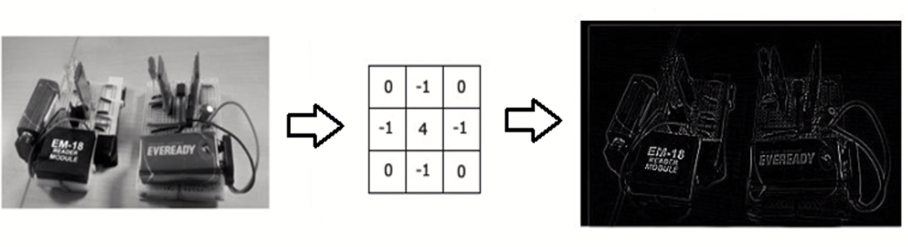
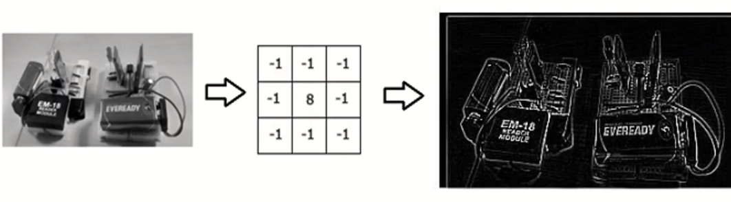
Final output after applying the Kernels:
Vertical and Horizontal direction
All direction including the diagonals

Slide 39
Bibliography
Help taken from the Internet through the various sites:
https://en.wikipedia.org/wiki/Edge_detection
And from youtube, lectures by Shriram Vasudevan
https://www.youtube.com/watch?v=97PLw2eNpaQ&list=RDCMUCma2b1uVLajAq9nHSEJh9HQ&start_radio=1&rv=97PLw2eNpaQ&t=5
And some form books DIGITAL IMAGE PROCESSING
https://drive.google.com/file/d/12YYTTPgBNwSD_BTXWHanlsRX9vxdMqxJ/view?usp=sharing

Slide 40
Thank YOu

